Slide 1
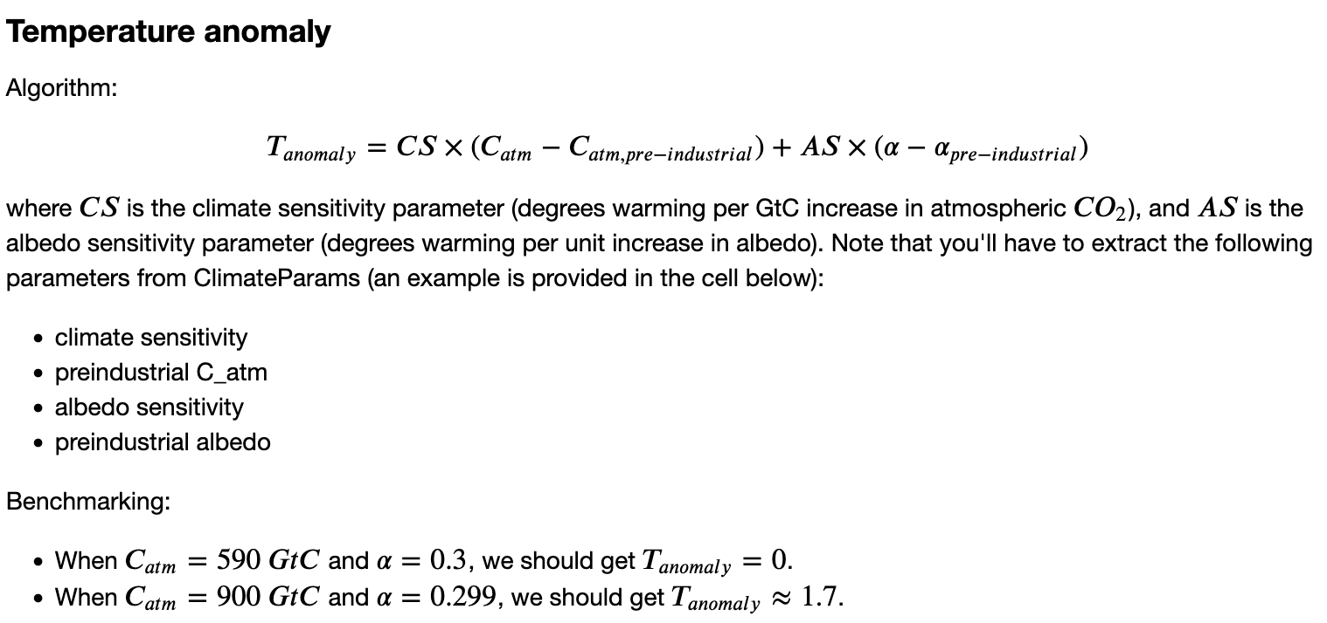
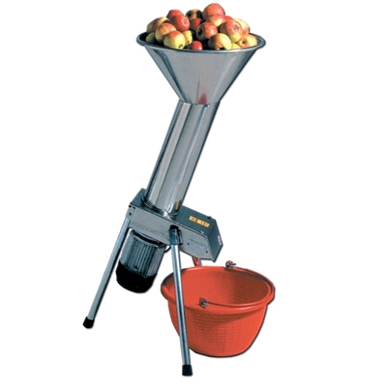
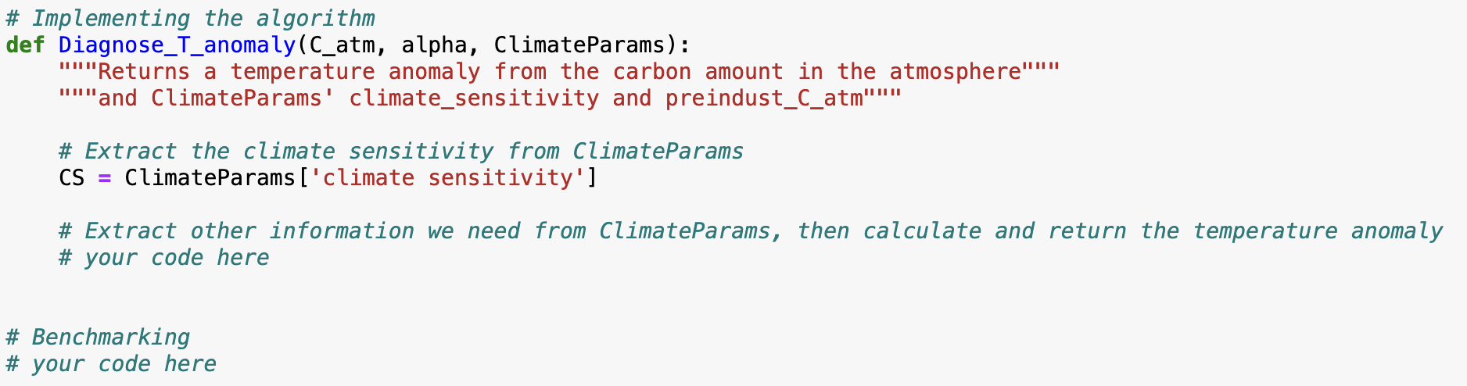
Recap: you wrote functions in Python, with benchmarking (or unit testing)
C_atm, alpha, and ClimateParams go in
T_anomaly comes out

Slide 2
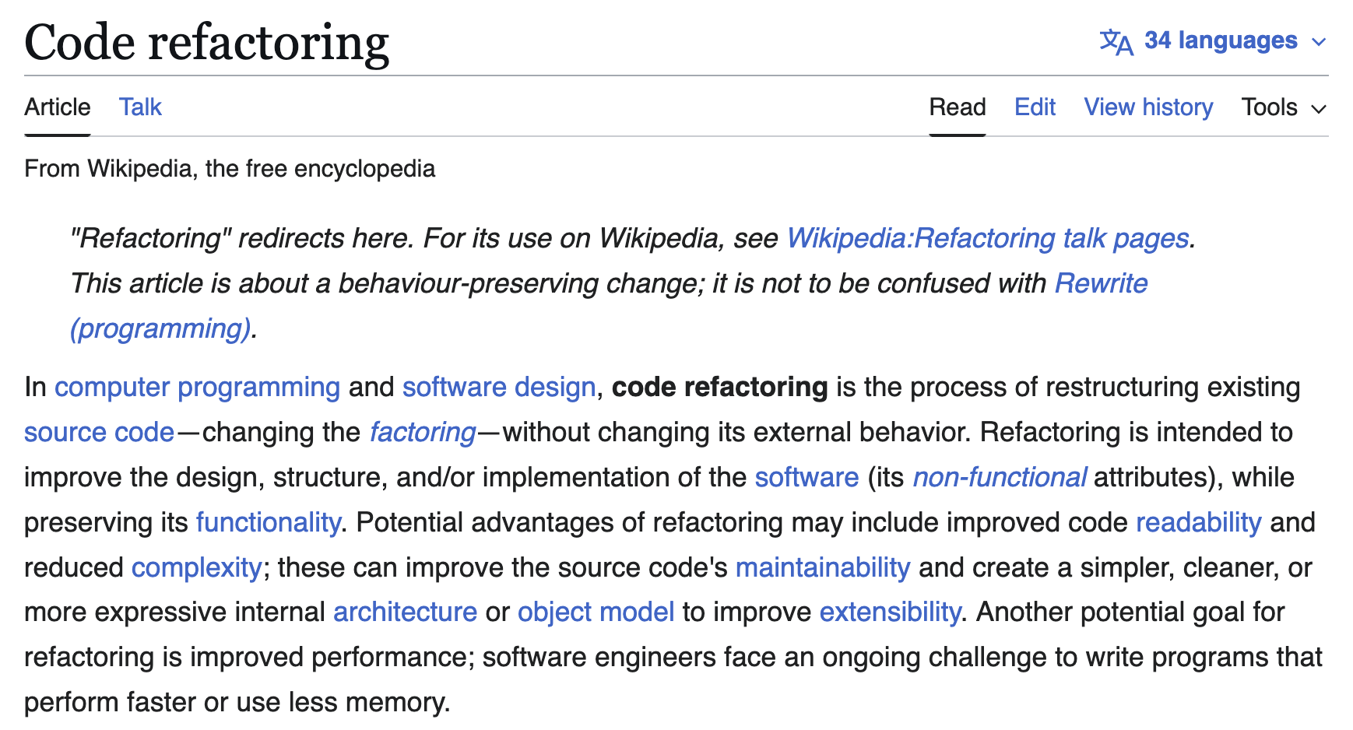
We also introduced the idea of refactoring

Slide 3
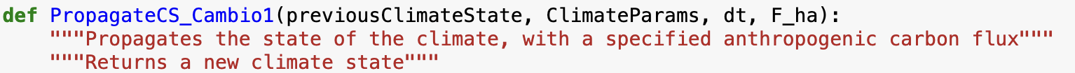
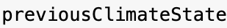
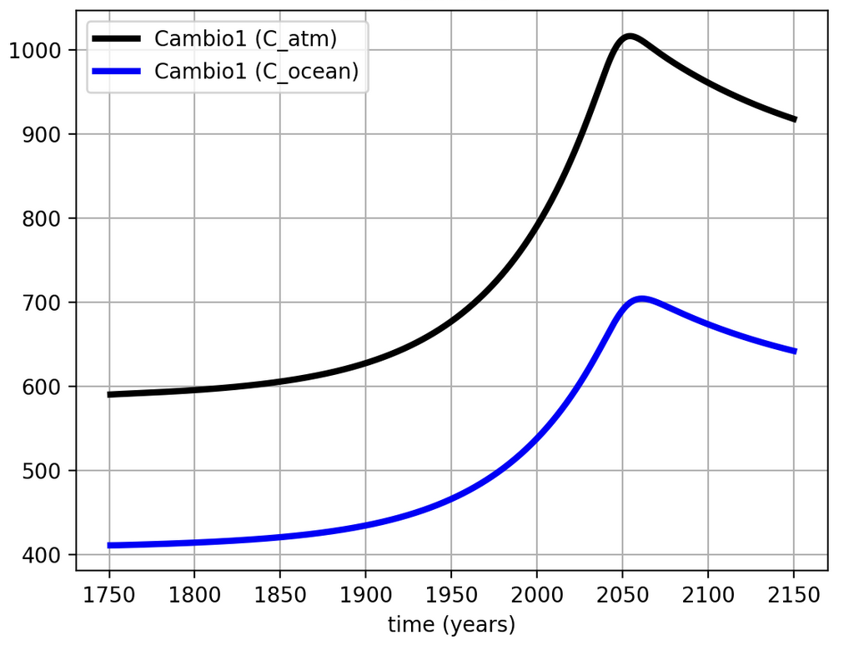

Part of that refactoring involved writing propagators for Cambio 1.0 and Cambio 2.0

Slide 4
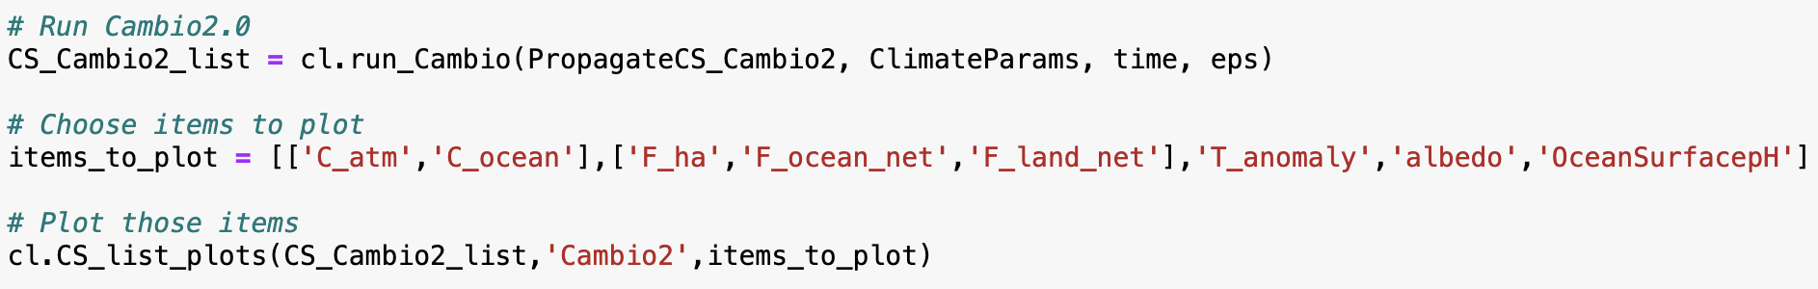
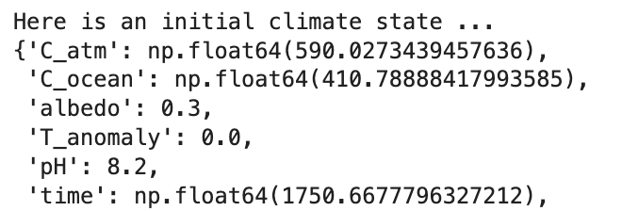
Refactoring let us take advantage of cl.run_Cambio to integrate over time

Slide 5
Refactoring also allowed us to take advantage of new code to plot the results

Slide 6

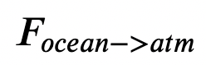
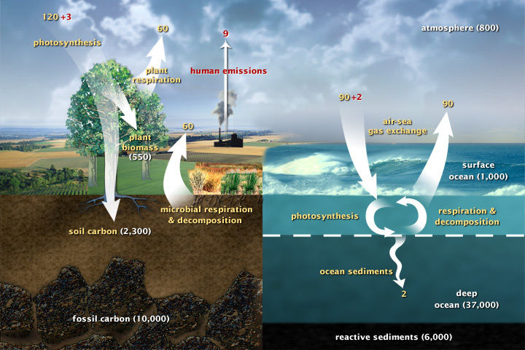
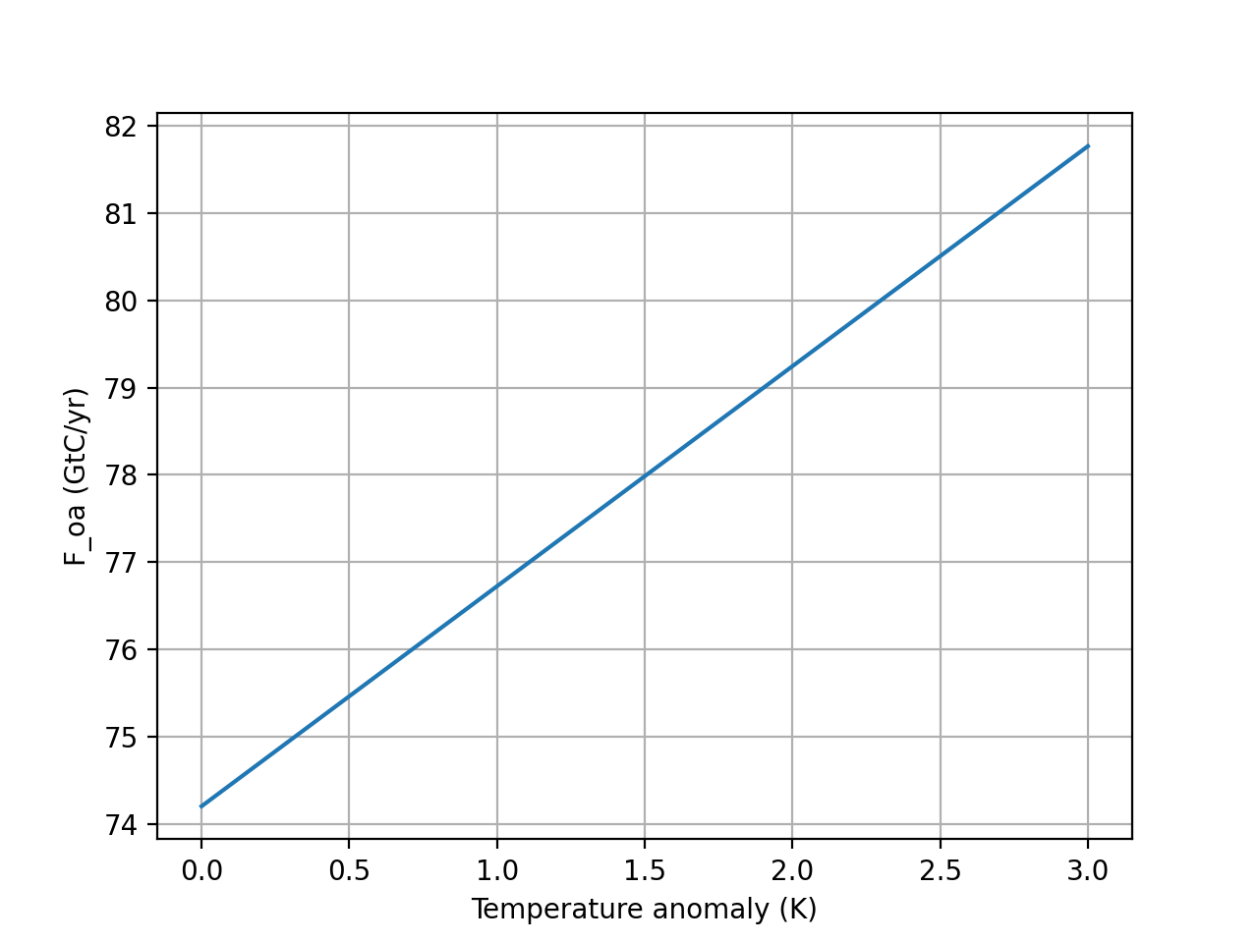


Our refactor also involved some new science: the van’t Hoff effect
$$F_{ocean→atm}=k_{oa}×(1+T_{anomaly}×DC)[C_{ocean}]$$
This is the Henry effect, whereby gases are less soluble in warmer oceans.
Cold ocean
Warm ocean
$$F_{ocean→atm}$$
$$T_{anomaly}$$

Slide 7

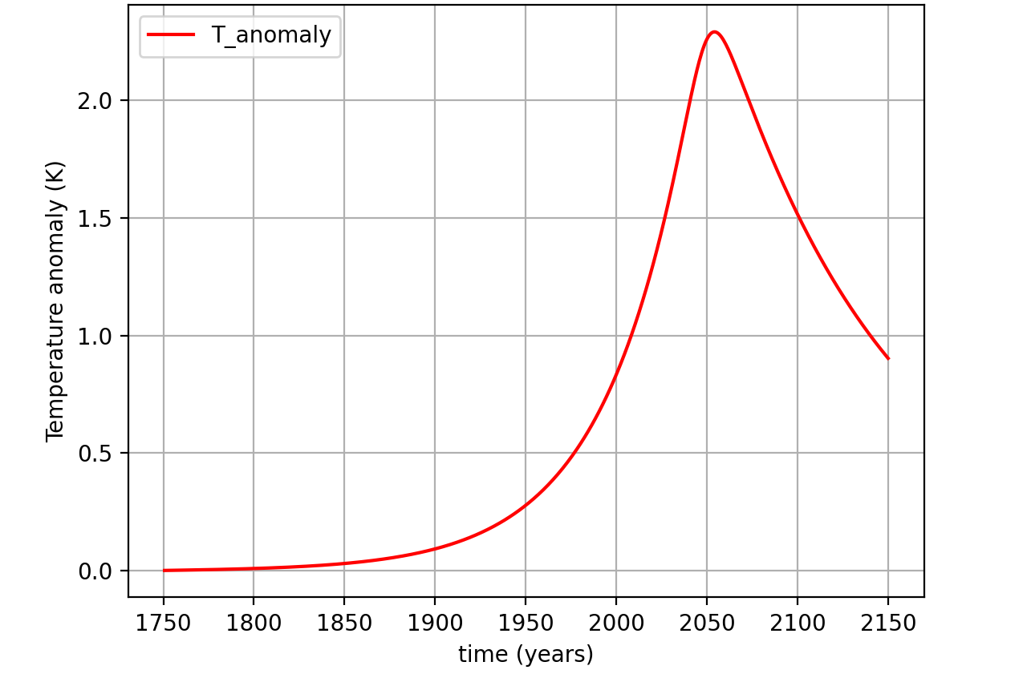
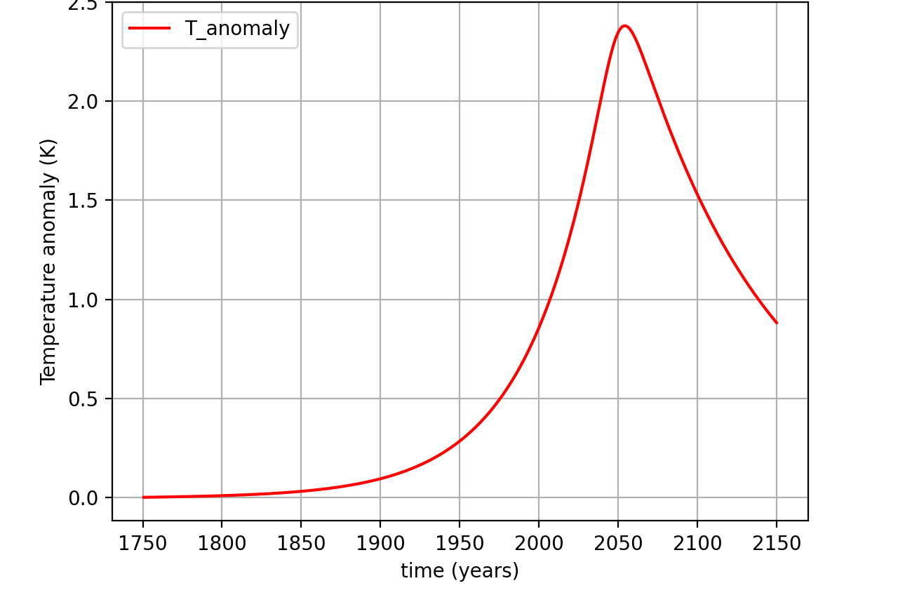
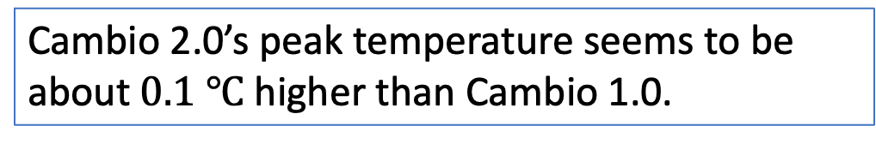
Lessons from Cambio 2.0: as several of you noted, the temperature impact is not great …
Cambio 1.0
Cambio 2.0
Cambio 2.0’s peak temperature seems to be about $0.1 ℃$ higher than Cambio 1.0.
Cold ocean
Warm ocean

Slide 8

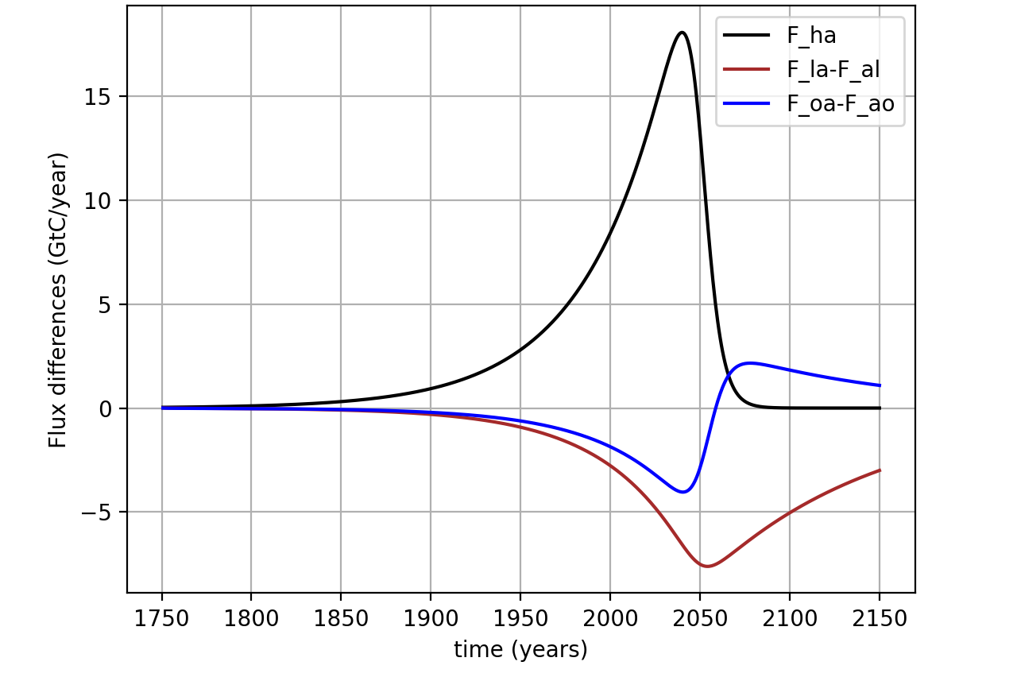

… partly because negative feedbacks helped compensate for one another
Cambio 1.0
Cambio 2.0
Cold ocean
Warm ocean

Slide 9
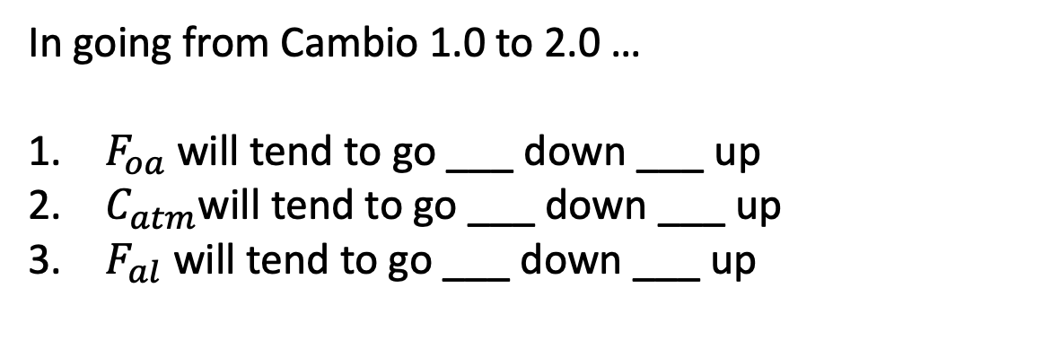


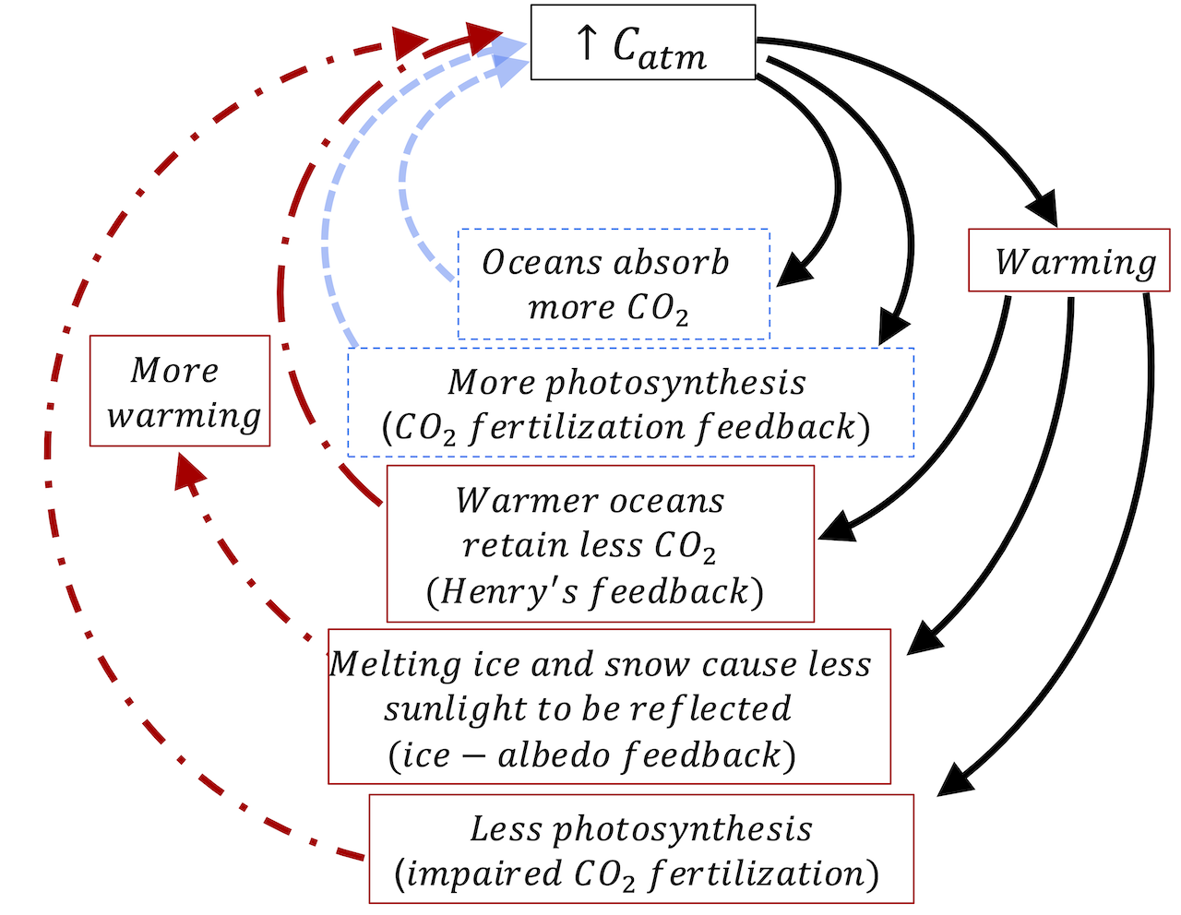
We even anticipated that compensating mechanism qualitatively, with a feedback diagram
Cold ocean
Warm ocean
Cold ocean
Warm ocean

Slide 10
We even anticipated that compensating mechanism qualitatively, with a feedback diagram
Cold ocean
Warm ocean
A small plug for us in this course: Imagine a course without Cambio … qualitative predictions like this would be all you could get!
Cold ocean
Warm ocean

Slide 11
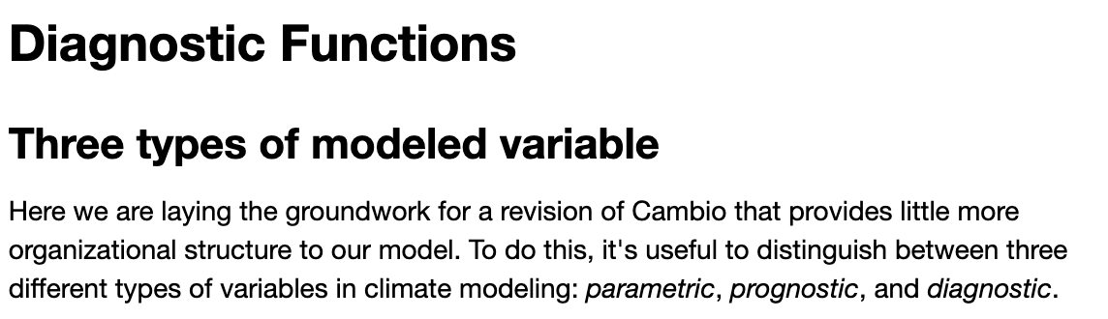
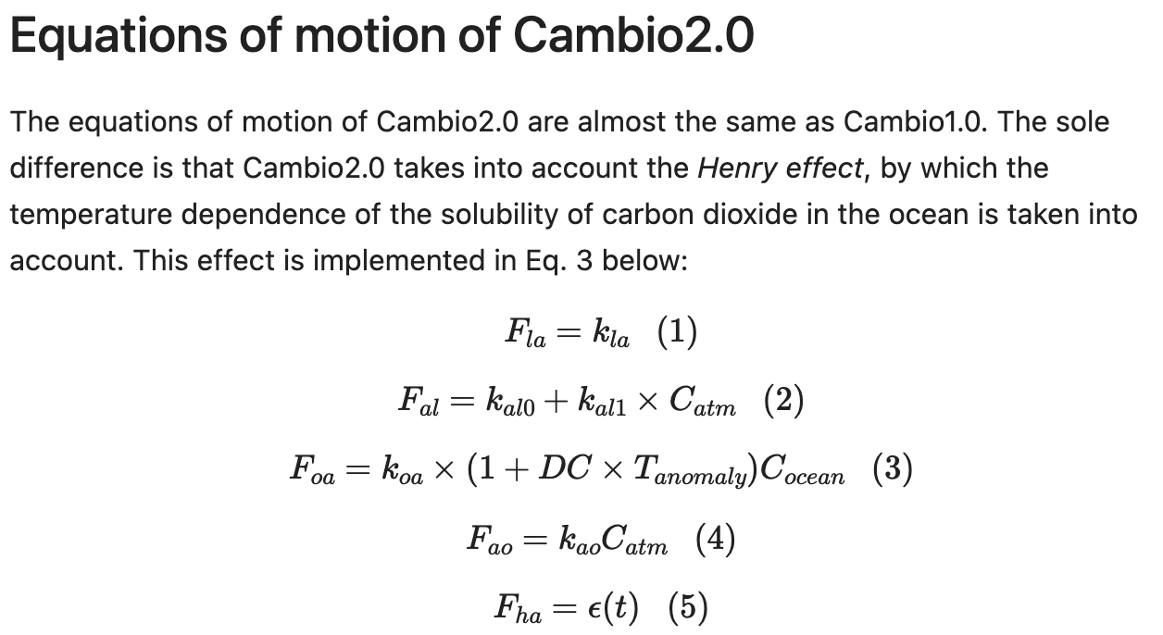
Meanwhile, let’s finish these up
Notes:
Predict the temperature if CO2 continues to rise. If we reduce CO2 emissions to zero.

